Slide 1
FAPTC
Faculty Appointment, Promotion and Tenure Committee

Slide 2
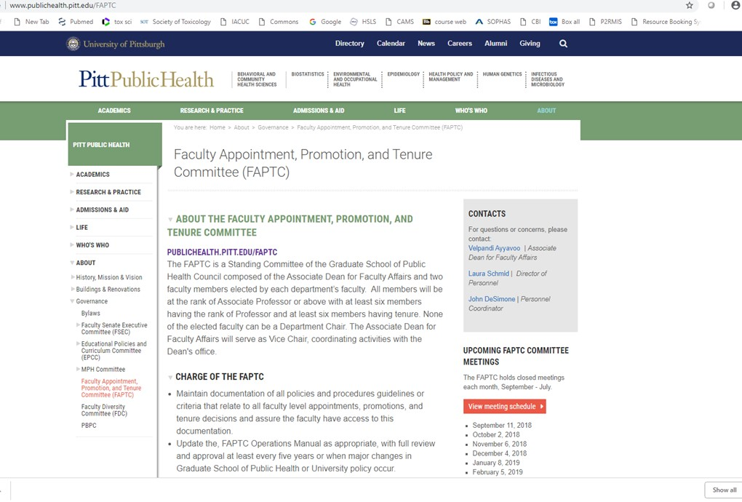

Slide 3
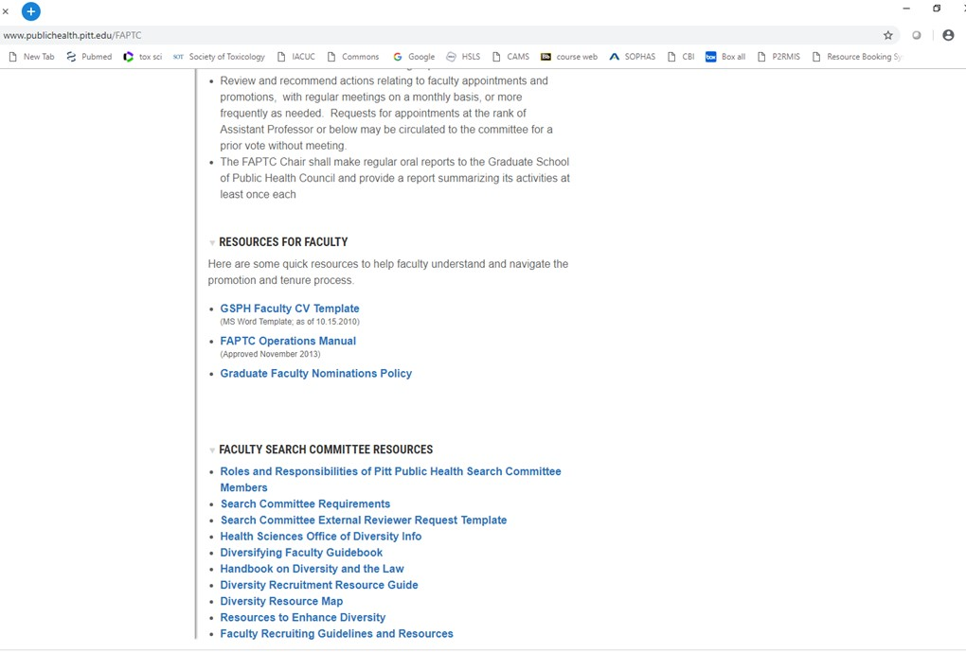

Slide 4
Academic Year 2018
Decisions on approximately 18 primary faculty appointments and promotions.
Extensive discussions on improving processing of dossiers and procedures.
Finalized the FAPTC operating manual including extensive discussion of the infamous Appendix D.

Slide 5
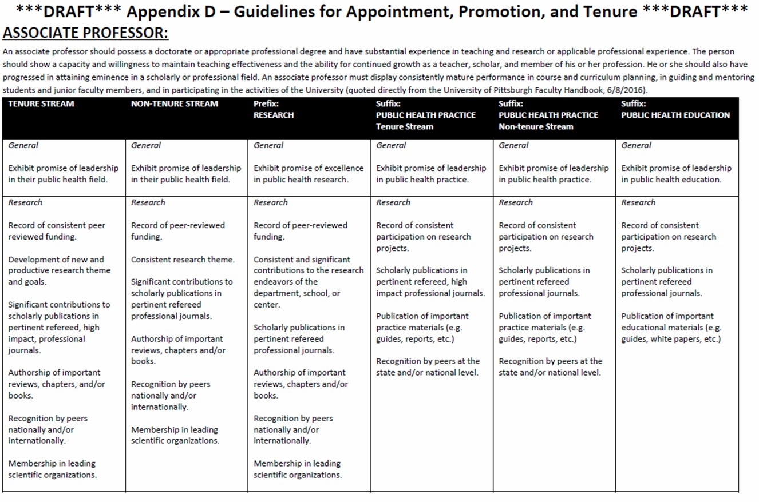
Guidelines for evaluation
NOT A CHECK LIST

